Slide 1
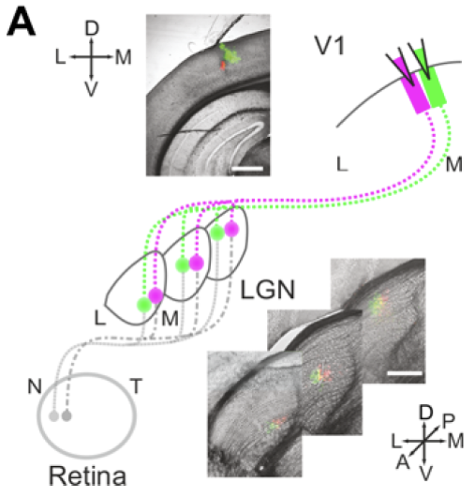
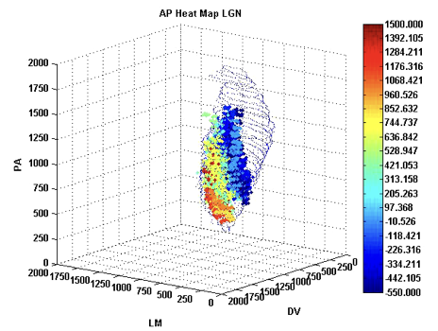
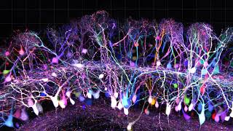
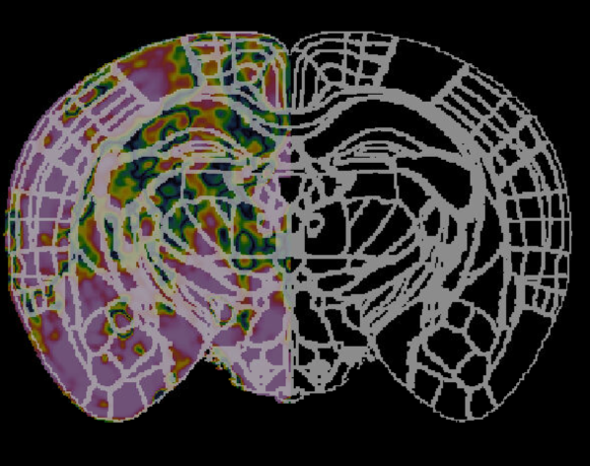
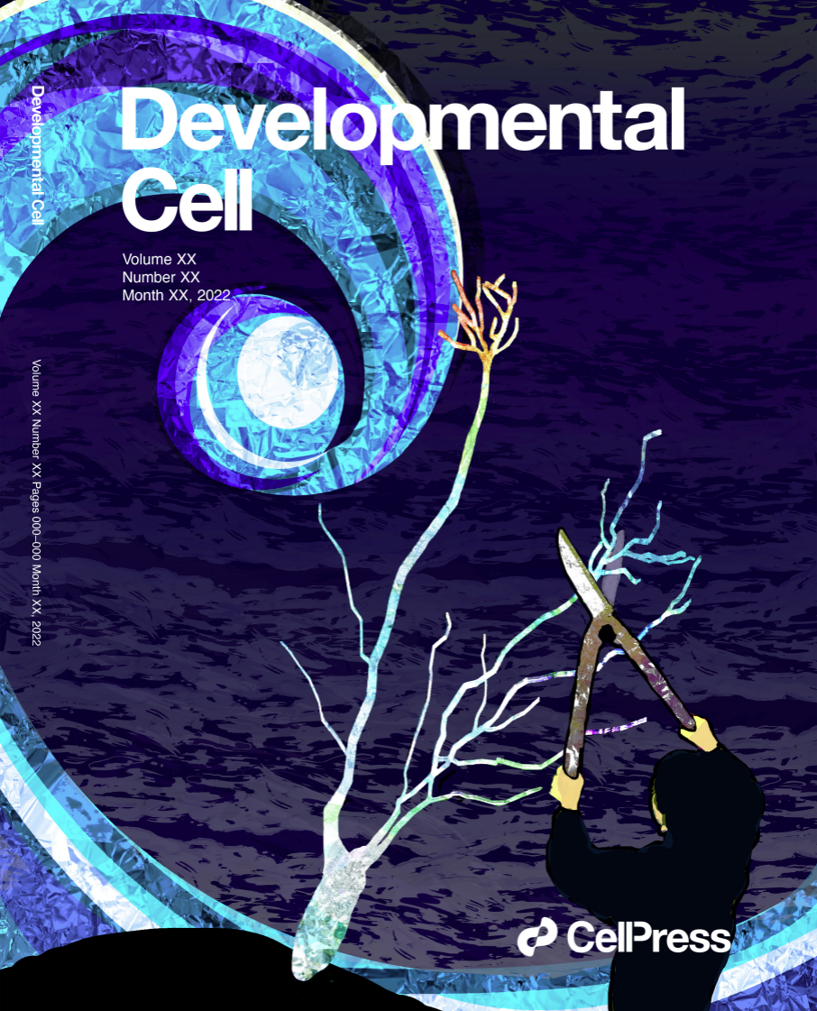

Who am I?
1. PhD in Visual Neuroscience (King’s College London)
3. Assistant Professor + Data Science (Kyushu University)
Python,
Image segmentation, Image processing,
Dimension reduction (tSNE, UMAP),
Modelling,
Machine learning,
Clustering algorithms
Image registration, stitching, bootstrapping, dimension reduction (PCA and PLS)
2. Post-doctoral research on Brain Activity during development(RIKEN)
4. Data Scientist and Technical Project Manager (Metacell)
Consulting data scientist,
Familiarity with cloud working (K8s),
SQL,
Absorbed modern business practices (e.g. Agile methodology, user stories, etc..)
Signal analysis, Motion correction, Arduino, building analysis pipelines

Slide 2
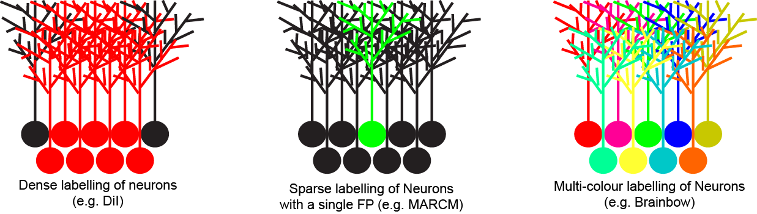
Case Study - Neural Connectomics
Multi-colour labelling is a strategy to uniquely identify hundreds of neurons at the same time.
Means we can begin to build a comprehensive connectome (brain map) cheaper and faster than ever before.

Slide 3
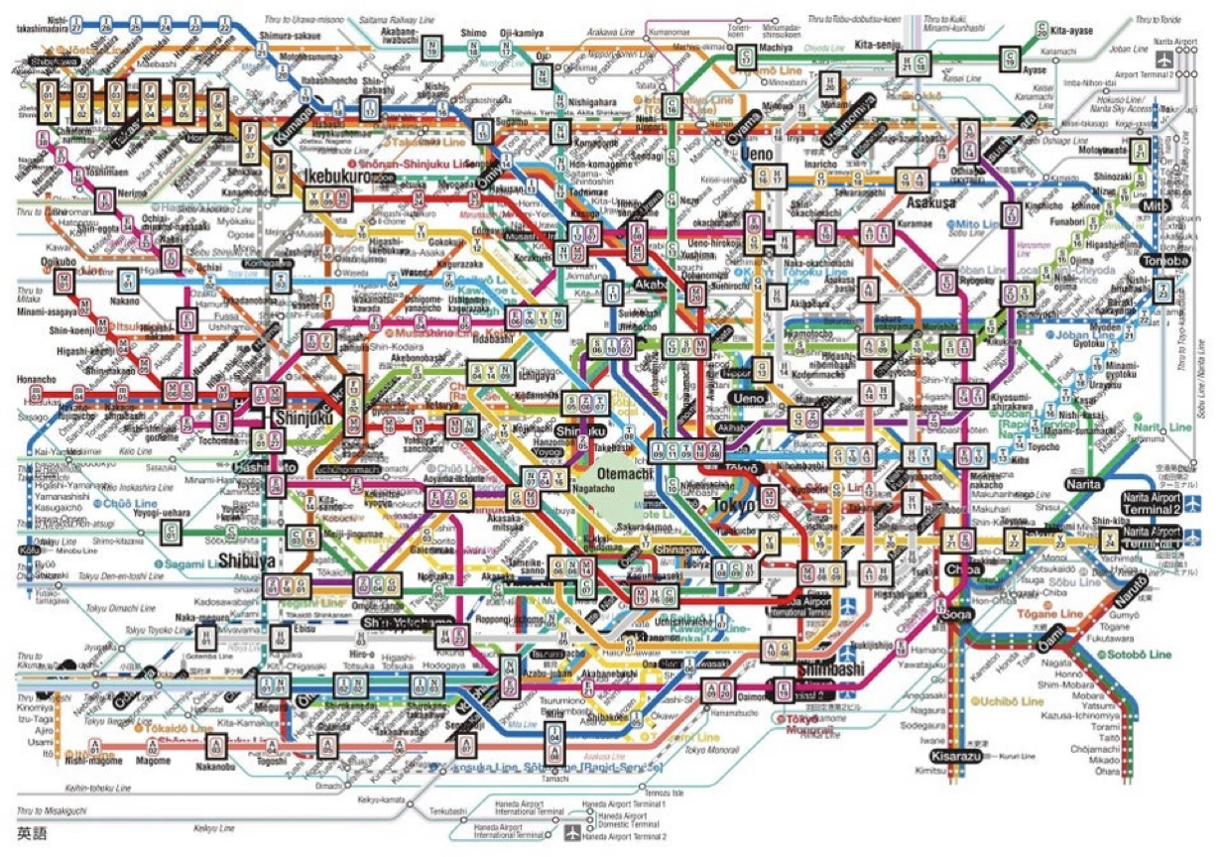
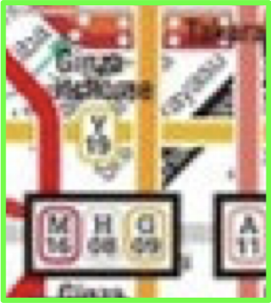
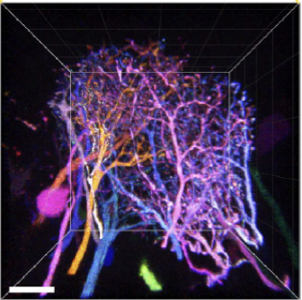
The problem - We need a lot of colours
Image created by randomwire.com

Slide 4
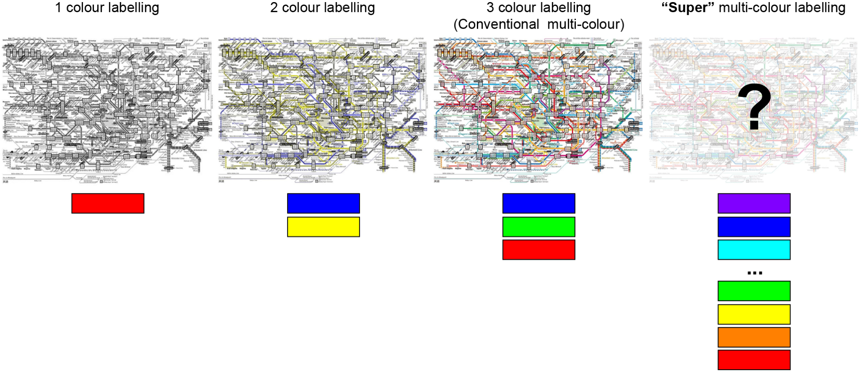
For a lot of colours we need to go beyond the human eye
1 colour combination
3 (2²-1) colour combinations
7 (2³-1) colour combinations
2^{n}-1 colour combinations

Slide 5

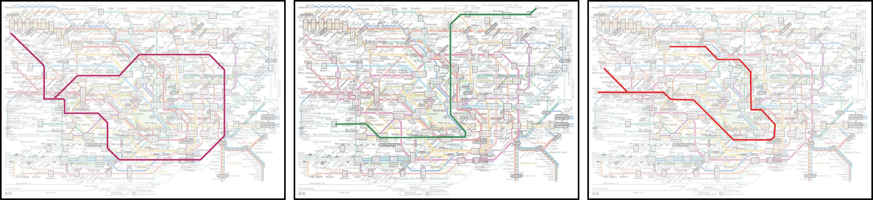

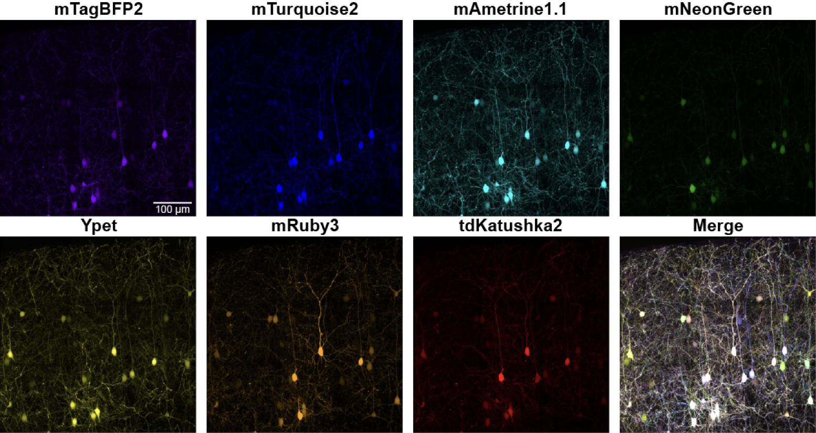
Identifying individual neurons
“QDyeFinder” Pipeline
Chromatic Aberration correction
Linear Unmixing
Signal to Noise evaluation
Signal consistency
Colour transformation
Colour identification

Slide 6
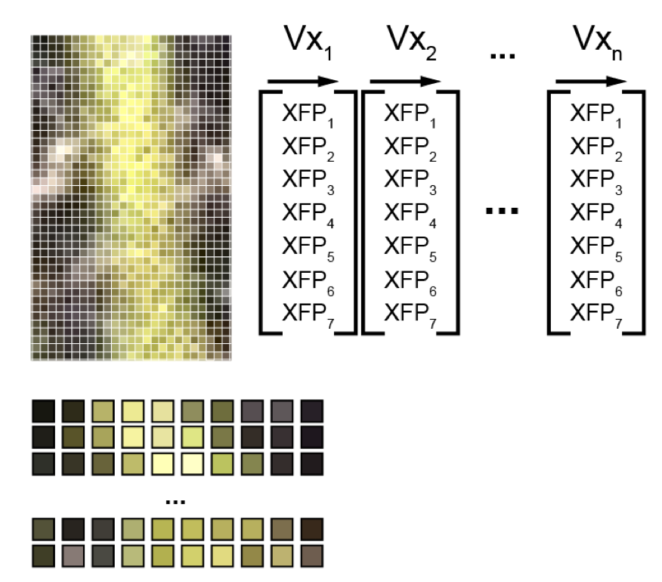
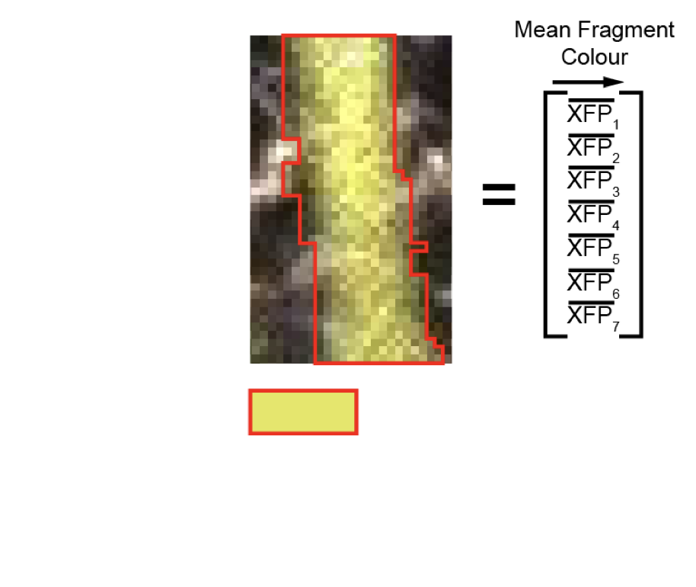
Image segmentation reduces processing
Pixel/Voxel based analyses
Segmentation/ROI based analyses

Slide 7
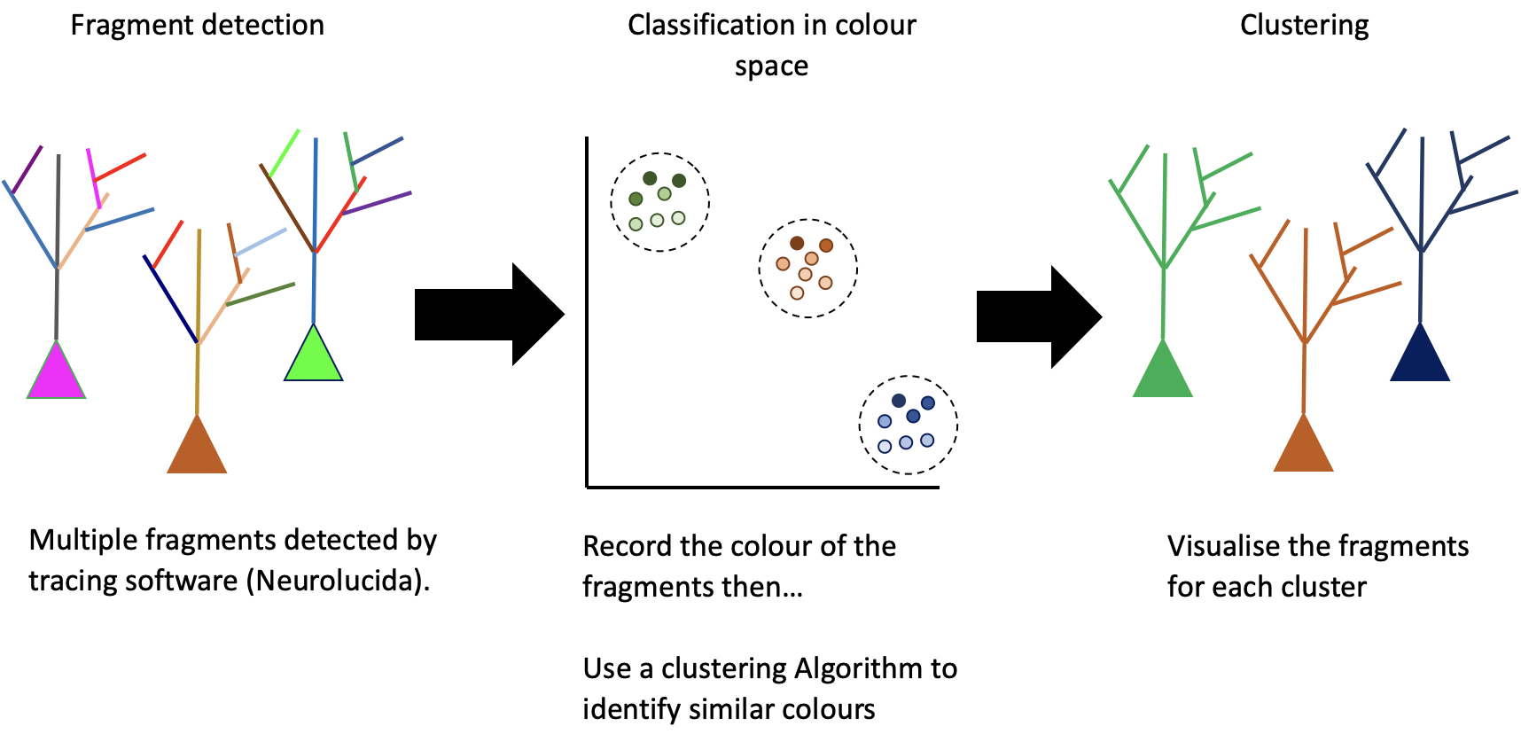
Essentially we now have a clustering problem

Slide 8
Existing Clustering algorithms are sub-optimal
Clustering Algorithm | K-means | Mean Shift Clustering | DBSCAN
What it measures | Distance | Density | Density and distance
Input required | #clusters (k) | A density kernel | Minimum number of points and distance
Advantage | Standard, fast | Outliers have a limited effect | Considers both the density and distance of the points (new gold standard)
Disadvantage | We don’t know the final number of clusters | Density of true clusters may be variable | Clusters produced can cover a large colour space

Slide 9
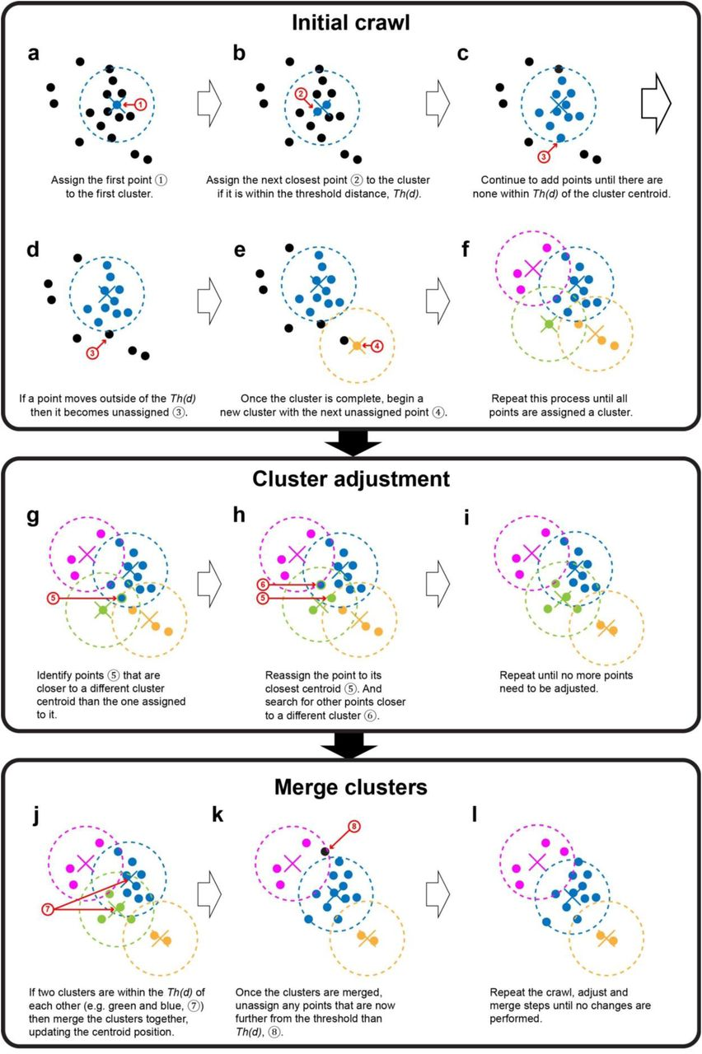
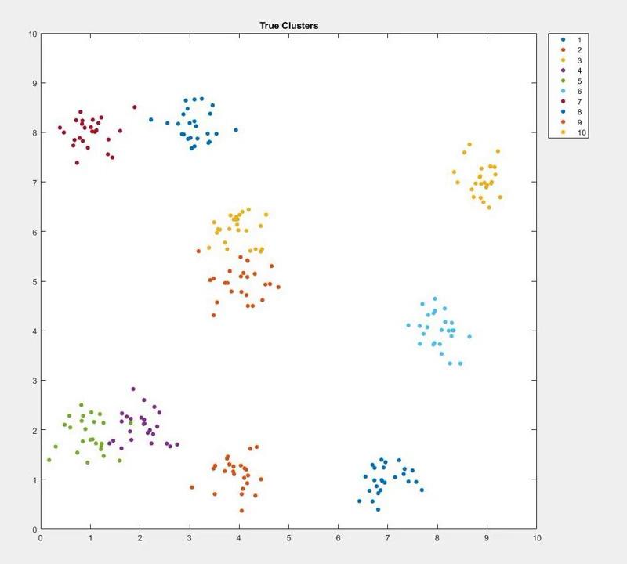
dCrawler: A new distance based clustering algorithm

Slide 10
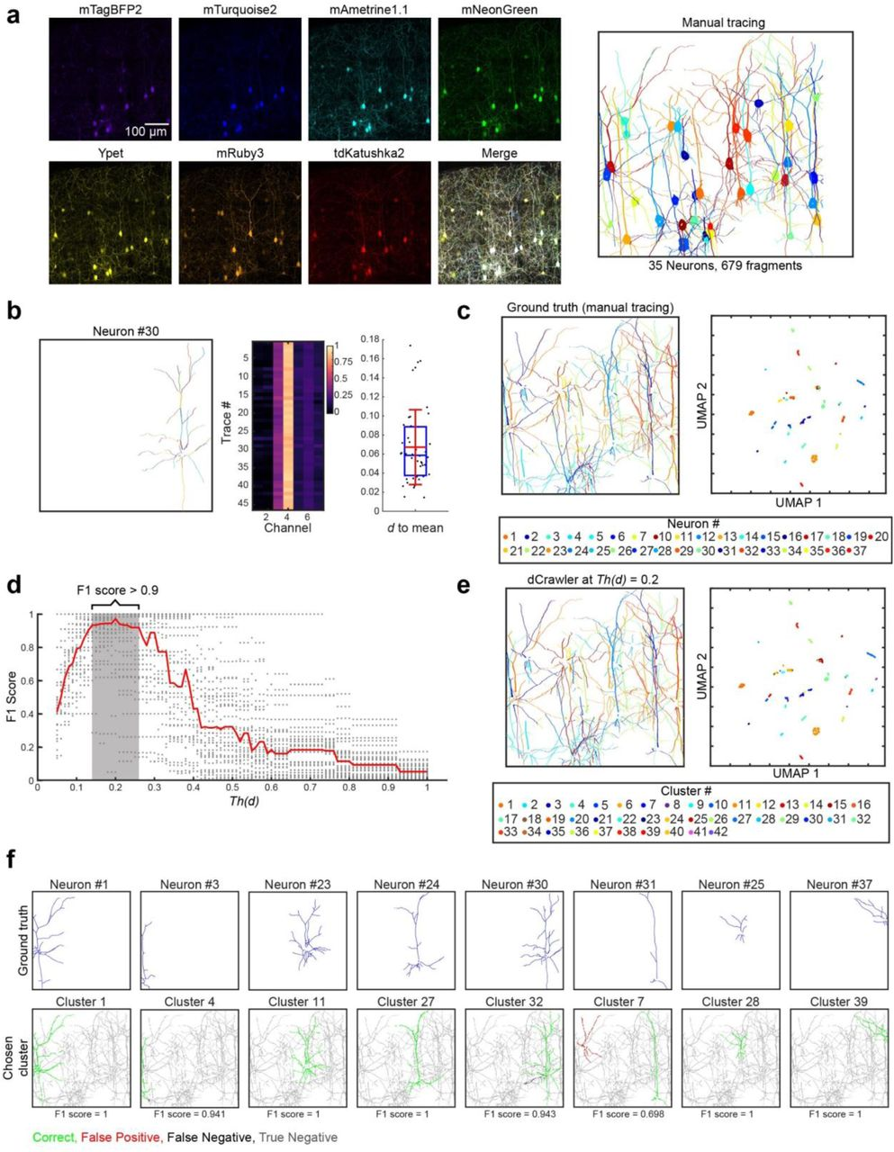
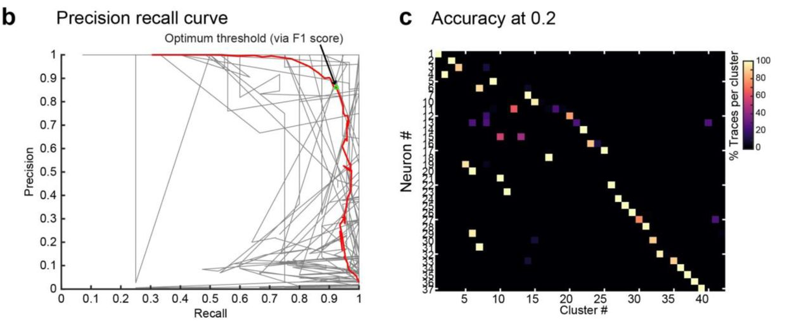
dCrawler: A new distance based clustering algorithm

Slide 11
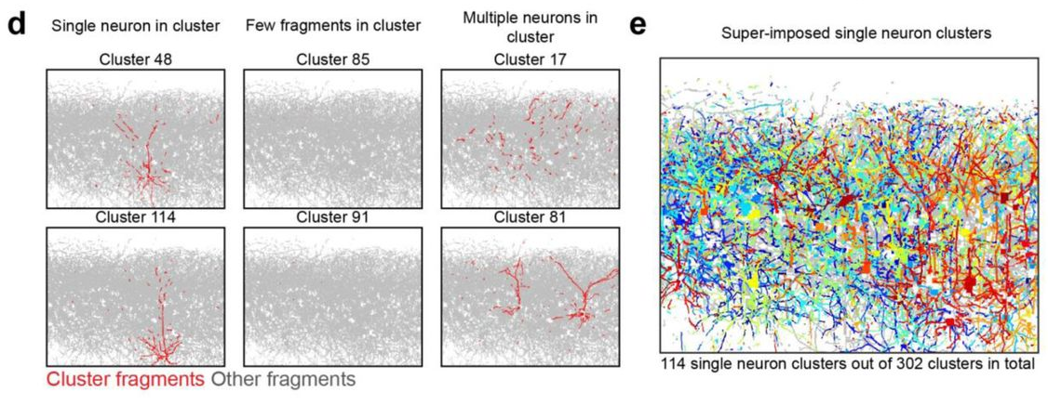
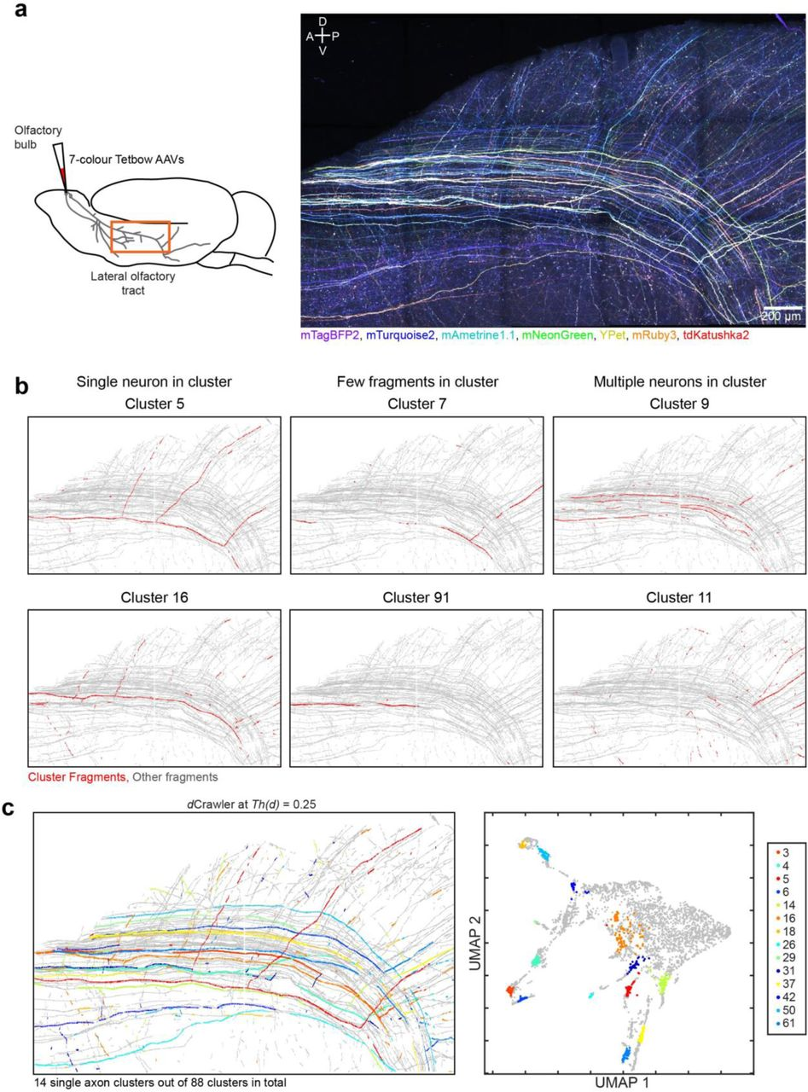
dCrawler: Effective in sub-optimal conditions too

Slide 12
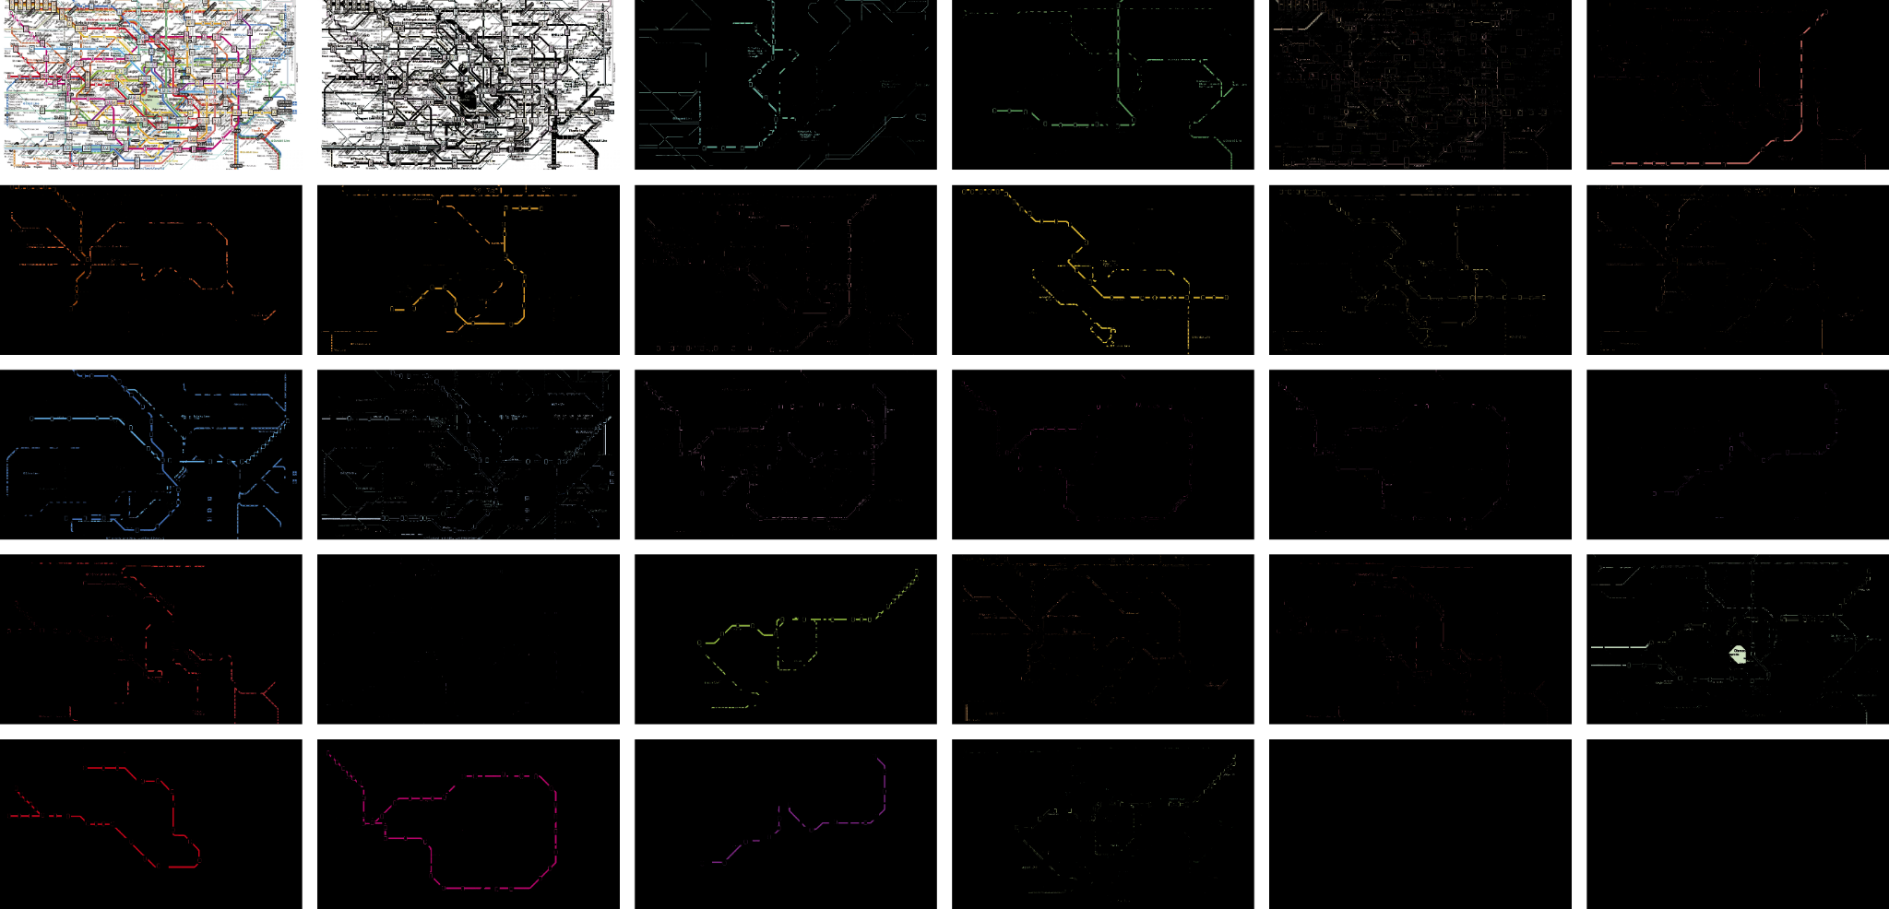
dCrawler: Able to separate colours in images too

